Slide 1

DR. NOUR MOHAMED
Attack Surface Analysis and Reduction
Presented by : Sandra Kolta , Nada Mamdouh , Adam Issa

Slide 2



What is Attack Surface?
The total sum of all potential entry points into a system.
Includes every pathway an attacker can use to compromise your environment.
It extends across Code, Ports, Services, APIs, and People.

Slide 3

Analogy: The Digital House
Every door, window, or unpatched pipe is an entry.
More entry points = Higher risk.

Slide 4

Why It Matters: Proactive Defense
80% of breaches originate from known, unpatched vulnerabilities.
Attack Surface Management is foundational cybersecurity.

Slide 5

Analyzer (ASA):
Core Goal: Achieve complete visibility of all assets—known and unknown
Key Function: Identifies Shadow IT, orphaned services, and unauthorized misconfigurations.
Method: Automated scanning and comprehensive inventory creation.

Slide 6

ASA: Mapping the Components
Digital Assets: Open ports, exposed APIs, and web services.
Configuration: Misconfigured defaults, unused software, and unsecure registry keys.
Human Elements: User privileges, default accounts, and access management gaps.

Slide 7
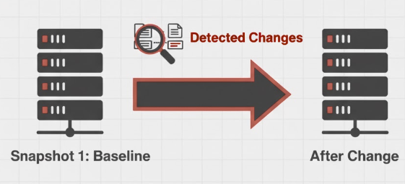
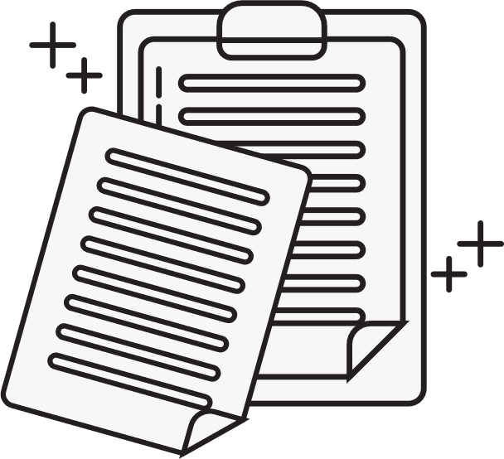

ASA in Action: Snapshot Analysis
Baseline: Analyzer records the clean, initial state of the system.
Comparison: It tracks changes over time by comparing the "before" and "after" snapshots.
Output: Provides a prioritized report of changes that introduce the most critical risks (Deep Red focus).

Slide 8
Reducer (ASR) :
Core Goal: Minimization. Strategically closing the number of exploitable entry points.
Impact: Increases the cost and time required for any attacker to achieve a breach.
Focus: Applying security controls to exposed and critical assets identified by ASA.

Slide 9

Four Strategic Attack Surface Reduction (ASR) Techniques
Enforce Least Privilege (PoLP)
Establish Secure Baselines
Core Principle: Grant the minimum level of access strictly necessary for users and applications to function.
Action: Eliminate unnecessary administrative rights and enforce Role-Based Access Control (RBAC) immediately.
Action: Enforce a hardened configuration by changing default settings (e.g., passwords) across all devices and applications.
Priority: Apply all patches immediately and consistently; unpatched software is a massive liability.
Disable and Remove Unused Services
Implement Network Segmentation
Core Principle: Logically separate critical, high-value assets (like databases) from the general user network.
Why: Dramatically reduces the lateral movement an attacker can achieve if a single user machine is compromised.
Action: Conduct audits to disable or uninstall all unneeded services, ports, and default applications.
Why: Every open port or inactive service is a potential, unmonitored entry point for an attacker.

Slide 10
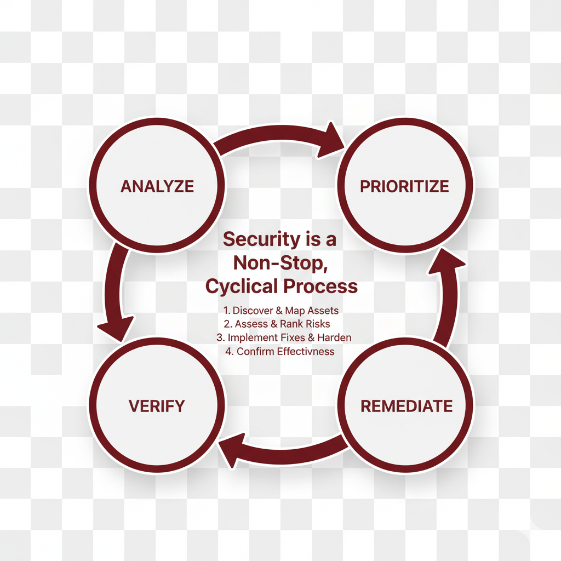


The Continuous ASM Lifecycle
Security is a Process: Attack Surface Management is a non-stop, cyclical process.
Steps: It flows from Analysis to Prioritization and then Remediation.
Verification: The cycle must conclude by re-analyzing the results to ensure reduction was effective.

Slide 11
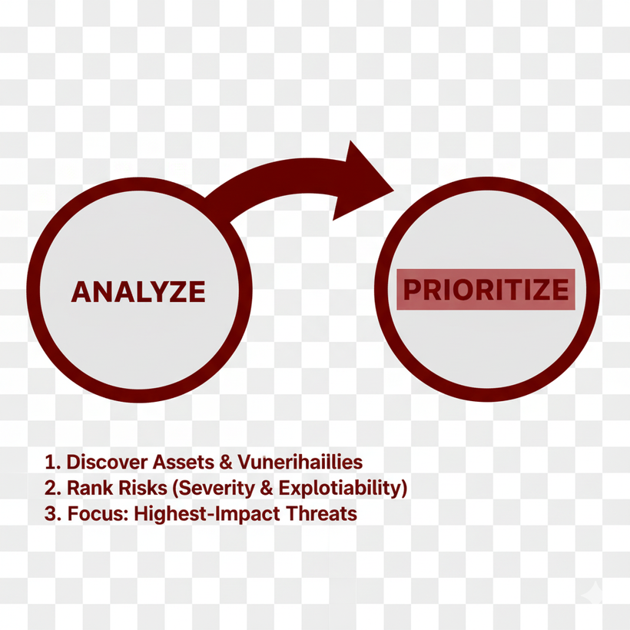

Lifecycle Phase 1: Analyze -> Prioritize
Analyze: Use tools (like ASA) to discover assets and vulnerabilities.
Prioritize: Rank risks based on severity (how bad it is) and exploitability (how easy it is to use).
Focus: Direct limited security resources to fix the highest-impact threats first.

Slide 12
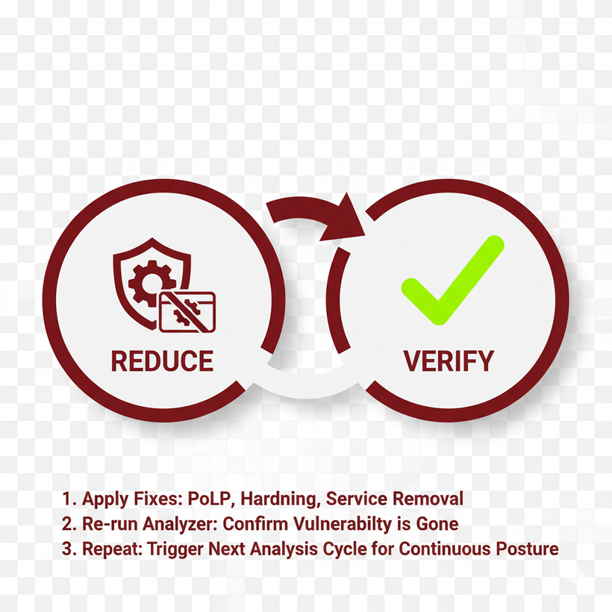

Lifecycle Phase 2: Reduce -> Verify
Reduce: Apply the ASR techniques: PoLP, configuration hardening, and service removal.
Verify: Re-run the Analyzer tool to confirm the vulnerability is truly closed or filtered.
Repeat: The verification step triggers the next analysis loop, ensuring continuous security posture.

Slide 13

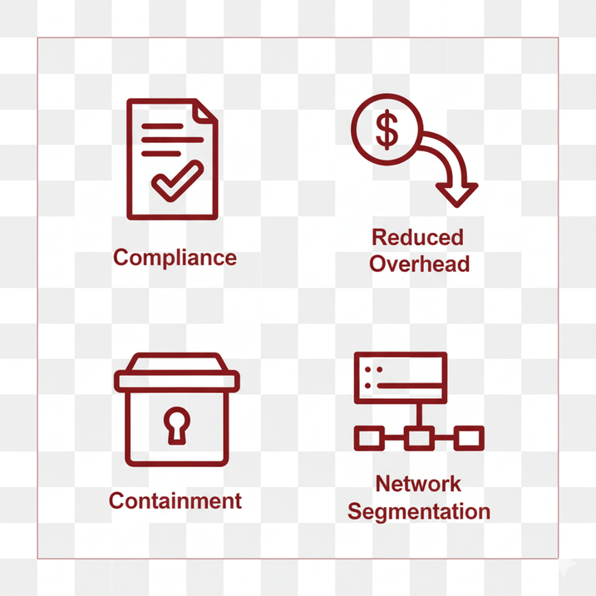
Summary of Benefits
Compliance: Provides auditable evidence of continuous risk assessment and mitigation efforts.
Reduced Overhead: Less complex systems require less maintenance and fewer emergency fixes.
Containment: Reduces the lateral movement pathways for malware during an incident.

Slide 14

HERE COMES THE DEMO !

